Slide 1
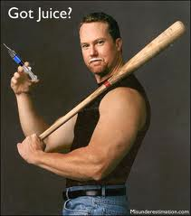
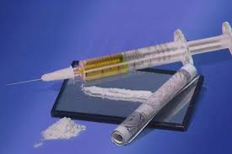
Chapter 9 Drug Identification and Toxicology
*
Forensic Science: Fundamentals & Investigations, Chapter 9

Slide 2
What is Forensic Toxicology?
Toxicology- the degree to which a substance is poisonous or can cause injury.
Forensic toxicology helps determine cause-and-effect relationships between
Exposure to a drug or other substance
and
Toxic or lethal effects from that exposure
*
Forensic Science: Fundamentals & Investigations, Chapter 9

Slide 3
How Can People Be Exposed to Toxic Substances?
People can be exposed to toxic substances:
intentionally— by treating illness or relieving pain
accidentally— by harmful combinations or overdoses
deliberately— by harming or killing others, or by suicide
*
Forensic Science: Fundamentals & Investigations, Chapter 9

Slide 4
Poison—Murder, Accidental Overdoses, and Drug Offences
Poisoning causes less than ½ of 1% of all homicides
Accidental drug overdoses are more common
Drug offenders
More than 50% of the federal prison population
About 20% of the population in state prisons
*
Forensic Science: Fundamentals & Investigations, Chapter 9

Slide 5
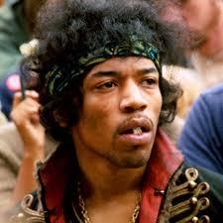
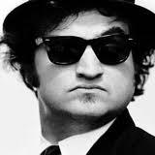
FAMOUS ACCIDENTAL DRUG OVERDOSES
John Belushi
Chris Farley
River Phoenix
Jim Hendrix
Jim Morrison
Janis Joplin
Anna Nicole-Smith
Steve Clark
*
Forensic Science: Fundamentals & Investigations, Chapter 9

Slide 6
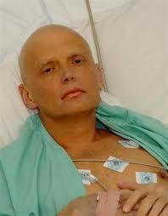
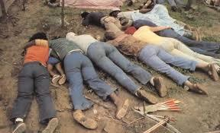
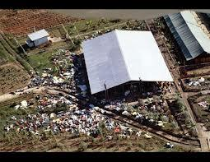
FAMOUS MURDERS BY POISON
Russian Ex-Spy Alexander Litvinenko 2006 (Radiation)
Jonestown cult members (900) 1978 (Cyanide)
Georgi Markov, Bulgarian dissident 1978 (Ricin)
*
Forensic Science: Fundamentals & Investigations, Chapter 9

Slide 7
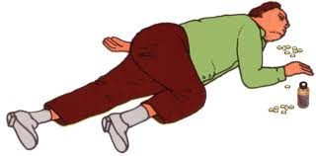
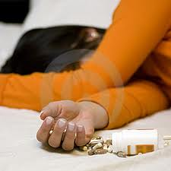
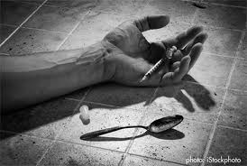
Controlled Substances
Hallucinogens
Narcotics
Stimulants
Anabolic steroids
Depressants
*
Forensic Science: Fundamentals & Investigations, Chapter 9

Slide 8
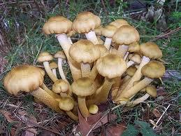
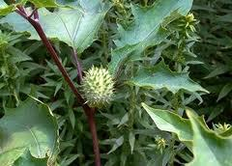
Controlled Substances —Hallucinogens: What is it?
Often derived from plants
The effect and intensity of response to these drugs varies from person to person.
Affects the user’s perceptions, thinking, self-awareness, and emotions
*
Forensic Science: Fundamentals & Investigations, Chapter 9

Slide 9
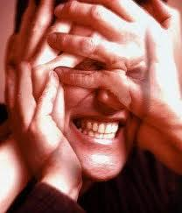
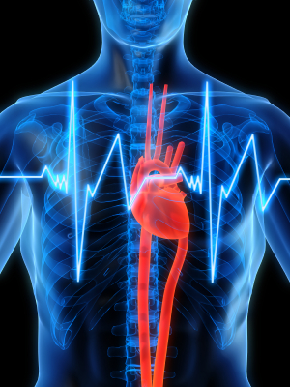
Controlled Substances —Hallucinogens: What are the Effects?
Affects of an overdose often include
Increased heart rate
Increased blood pressure
Panic attacks, anxiety, or psychosis
*
Forensic Science: Fundamentals & Investigations, Chapter 9

Slide 10
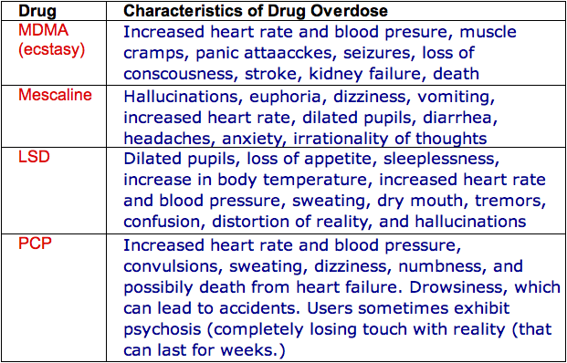
Controlled Substances —Hallucinogens: Examples
*
Forensic Science: Fundamentals & Investigations, Chapter 9

Slide 11
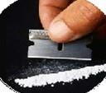
Controlled Substances —Narcotics:What is It?
A narcotic is a drug that is meant to sedate, or induce sleep. In less potent forms, this family of drugs is often used as a pain reliever because of its ability to relax muscles and provide relief as a sedative. Many illegal drugs that people often refer to as narcotics are actually not. Instead, some of these drugs, such as cocaine and methamphetamines, are actually stimulants, and therefore are the opposite of narcotics. Still, despite the improper use of the word, the term narcotic is often applied to all illegal drugs, especially in the law enforcement field.
*
Forensic Science: Fundamentals & Investigations, Chapter 9

Slide 12
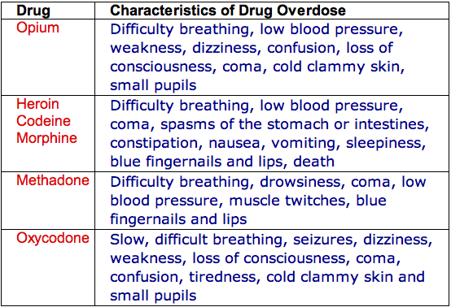
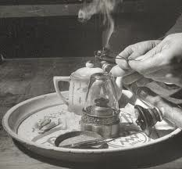
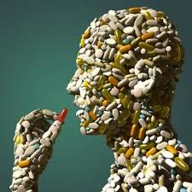
Controlled Substances —Narcotics:Examples
*
Forensic Science: Fundamentals & Investigations, Chapter 9

Slide 13
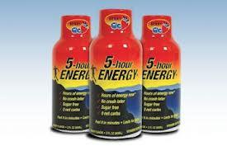
Controlled Substances —Stimulants: What is it?
Increases feelings of energy and alertness
Suppresses appetite
Afterwards, depression often results
Overdose affects include high blood pressure, agitation, confusion, seizures
Stimulants tend to be highly addictive
*
Forensic Science: Fundamentals & Investigations, Chapter 9

Slide 14
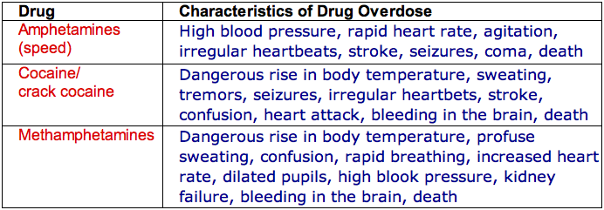
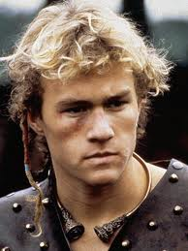
Controlled Substances —Stimulants: Examples
*
Forensic Science: Fundamentals & Investigations, Chapter 9

Slide 15
Controlled Substances —Anabolic Steroids: What is it?
A chemical structure similar to testosterone
Promote cell and tissue growth increasing bone mass and body muscle.
Popular with weightlifters, bodybuilders, and other athletes
What are some of the negative side effects?
*
Forensic Science: Fundamentals & Investigations, Chapter 9

Slide 16
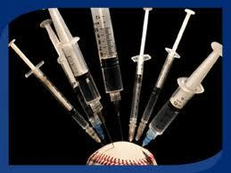
Controlled Substances —Anabolic Steroids: Examples
Anabolic steroids are mostly testosterone and its derivatives. Examples of anabolic steroids include:
* Testosterone
* Dihydrotestosterone
* Androstenedione (Andro)
* Dehydroepiandrosterone (DHEA)
* Clostebol
* Nandrolone
*
Forensic Science: Fundamentals & Investigations, Chapter 9

Slide 17
Controlled Substances —Depressants-What is it?
Depressants are drugs that inhibit the function of the central nervous system (CNS) and are among the most widely used drugs in the world. These drugs operate by affecting neurons in the CNS, which leads to symptoms such as drowsiness, relaxation, decreased inhibition, anesthesia, sleep, coma, and even death. All depressants also have the potential to be addictive.
Affects the central nervous system by increasing GABA activity, a neurotransmitter
Increased GABA causes drowsiness and slowed brain activity
Relieves anxiety and produces sleep
Side effects include slurred speech and loss of coordination
Mixing depressants with alcohol and other drugs increases potency and health risks
*
Forensic Science: Fundamentals & Investigations, Chapter 9

Slide 18
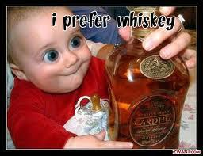
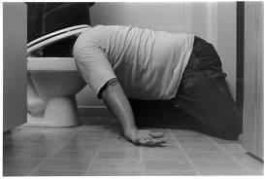
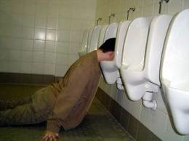
Controlled Substances —Depressants-Example#1
Ethyl alcohol
Alcohol, also known as ethyl alcohol, is the second most widely used psychoactive drugs in the world (caffeine is number one). One survey conducted by the Substance Abuse and Mental Health Services Administration found that nearly 70 million over the age of 12 reported participating in binge drinking or heavy drinking (2002).
Alcohol use and abuse also has high social costs. According to the American Psychiatric Association, approximately 50 percent of all assaults, homicides, and highway deaths involve alcohol (2000).
*
Forensic Science: Fundamentals & Investigations, Chapter 9

Slide 19
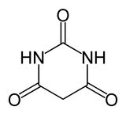
Controlled Substances —Depressants-Example #2
Barbiturates
Sometimes referred to as downers, are a type of CNS depressant that causes euphoria and relaxation when taken in low doses. During the early half of the 1900s, barbiturates were viewed as a safe depressant, but problems with addiction and deadly overdoses soon became apparent. Barbiturates have a dramatic impact on sleep patterns, resulting in suppressed REM sleep. Because the potential for addiction and misuse is so high, barbiturates are commonly replaced with benzodiazepines to treat anxiety and sleep problems.
Allobarbital
Amobarbital
Barbital
Pentobarbital
Phenobarbital
Secobarbital
*
Forensic Science: Fundamentals & Investigations, Chapter 9

Slide 20
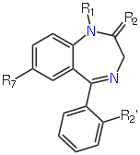
Controlled Substances —Depressants-Example #3
Benzodiazepines
They are a type of CNS depressant widely prescribed to treat anxiety and sleep disorders. In 1999, four different benzodiazepines were among the top 100 most prescribed drugs in the U.S. Because of their low toxicity and high effectiveness, benzodiazepines have been popularly used as a short-term treatment for anxiety problems and insomnia. However, their potential for dependency makes them a less preferred long-term treatment for such things as generalized anxiety disorder, post-traumatic stress disorders, and panic disorders
Alprazolam (Xanax)
Clonazepam (Klonopin)
Deazepam (Valium)
Lorazepam (Ativan)
Triazolam (Halcion)
*
Forensic Science: Fundamentals & Investigations, Chapter 9

Slide 21
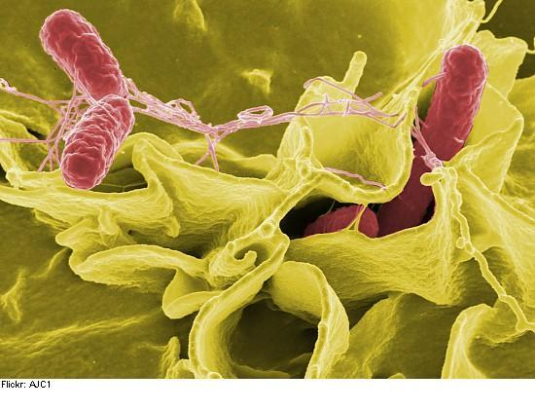
Controlled Substances —Bacterial Toxins-What is it?
Bacterial toxins are by-products produced by pathogenic microbes that have taken up residence in the body.
Bacterium can enter a host by various means, such as consuming contaminated food or water. Bacteria can also be introduced through mucous membranes, either by direct contact with the source or as a consequence of breathing in air-borne bacteria.
The type of bacterial toxins released depends on the species of invading bacteria.
Research by the University of Adelaide claims a bacterial toxin, named Subtilase cytotoxin, targets human cells that express the sugar Neu5Gc, found in animal foods.
*
Forensic Science: Fundamentals & Investigations, Chapter 9

Slide 22
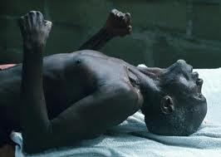
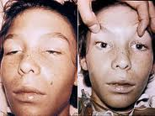
Controlled Substances —Bacterial Toxins-examples
Tetanus (also called Lockjaw)
Produced by the Clostridium tetani bacteria
Causes violent muscle spasms
Botulism
Produced by Clostridium botulinum—botulism
Paralyzes muscles
Causes irreversible damage to nerve endings
Extremely deadly in very small amounts
Most poisonous biological substance
*
Forensic Science: Fundamentals & Investigations, Chapter 9

Slide 23
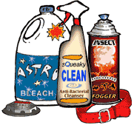
Controlled Substances —Pesticides and Heavy Metals-What is it?
A pesticide is a chemical used to prevent, destroy, or repel pests. Pests can be insects, mice and other animals, weeds, fungi, or microorganisms such as bacteria and viruses.
A heavy metal, in the general sense, is a metal which is toxic and has a high density, specific gravity or atomic weight.
*

Slide 24
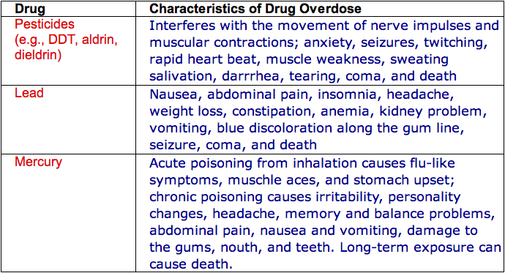
Controlled Substances —Pesticides and Heavy Metals-examples
*

Slide 25
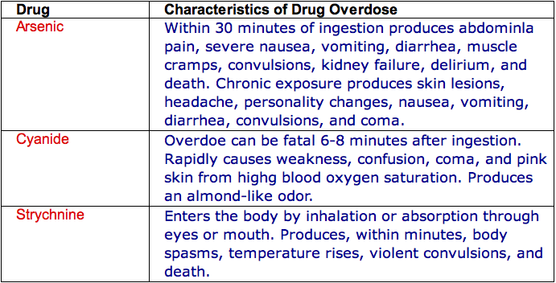
Controlled Substances —Pesticides and Heavy Metals-examples
*
Forensic Science: Fundamentals & Investigations, Chapter 9

Slide 26
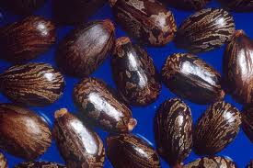
Controlled Substances —Bioterrorism Agents: Type #1
Ricin
A poisonous protein in the castor bean
Lethal in extremely small amounts
Enters the body in various ways:
inhaled as a mist or a powder
ingested as food or drink
injected into the body
Causes death within a few hours
*
Forensic Science: Fundamentals & Investigations, Chapter 9

Slide 27
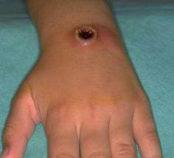
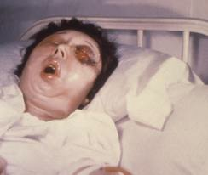
Controlled Substances—Bioterrorism Agents: Type #2
Anthrax
Bacillus anthracis, which forms endospores
Spreads to humans from infected animals
Enters the human body through:
Inhalation; causing breathing problems that usually result in death
Ingestion; becoming fatal in 25% to 60% of cases
Absorption via the skin; leading to death in about 20% of untreated cases
*
Forensic Science: Fundamentals & Investigations, Chapter 9

Slide 28
. . . . . . . . . Summary. . . . . . . .
Forensic toxicology seeks to identify poisons or drugs in criminals and victims.
Toxicology is important in studying cases of drug overdose and sporting violations.
Poisons can be produced by living organisms.
Pesticides and heavy metals are common poisons.
Bioterrorism agents include ricin and anthrax.
*
Forensic Science: Fundamentals & Investigations, Chapter 9

Slide 29
. . . . . . . . . . . . . Summary. . . .
Controlled substances fall into five main groups:
Hallucinogens
Narcotic
Stimulants
Steroids
Depressants
*
Forensic Science: Fundamentals & Investigations, Chapter 9

